Slide 1
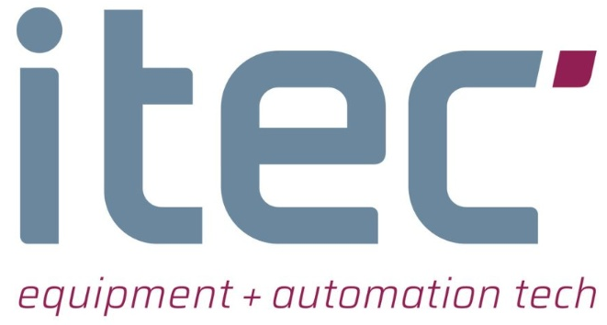

A Structured Inference Optimization Approach for Vision-Based DNN Deployment on Legacy Systems
Devi Darshini Manickam^{1,2}, Sajid Mohamed¹, Vibhor Jain², Dip Goswami², Leonard Lensink¹
¹ITEC B.V., ²Eindhoven University of Technology
ETFA 2023
12 September, Sinaia, Romania

Slide 2
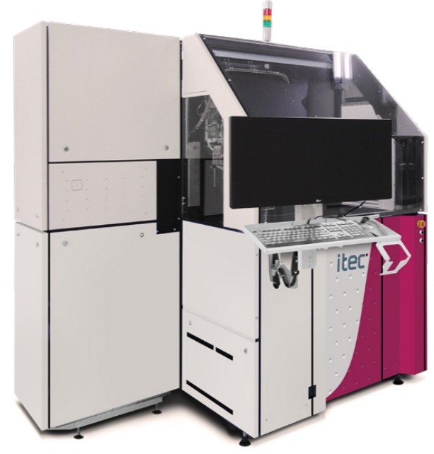
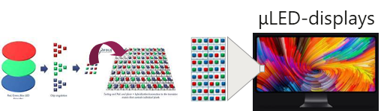
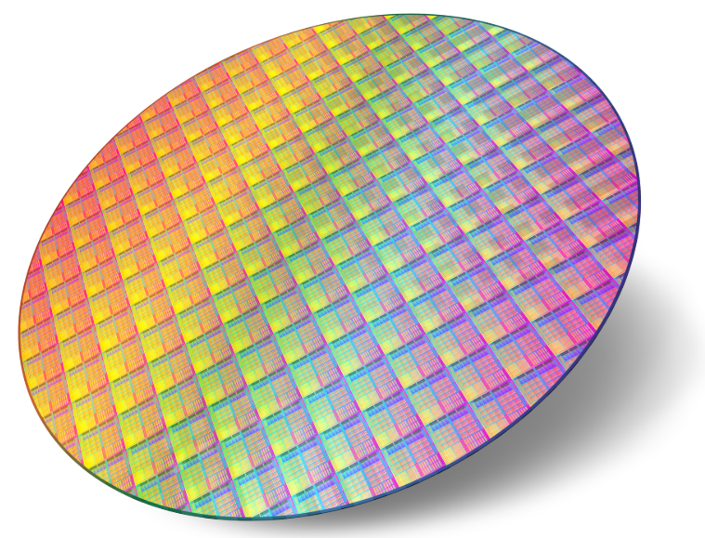
Motivation
ITEC’s ADAT3-XF PiXelect Bonder is a legacy system with
High throughput
Die bonding up to 72000 units per hour
High accuracy
3 μm ± 1σ bonding accuracy

Slide 3
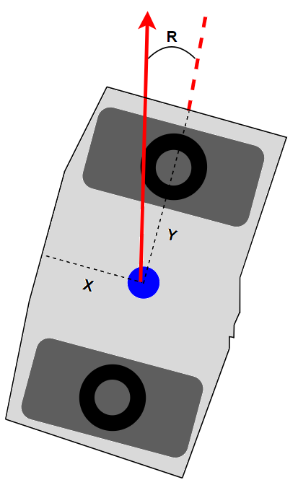
Motivation
Sometimes features in the image are not well-defined
Causes reduction in accuracy
Features of the die vary from customer to customer
Custom algorithms required → not robust
Constraints introduced by the legacy system
Goal → Model and deploy DNN in a legacy system
Die showing predicted X, Y and R Values

Slide 4
Challenge
Industrial brownfield architectures
Equipment with legacy hardware and software
Challenging requirements and constraints on the DNN deployment
Traditional inference optimisation approaches result in poor performance

Slide 5
Constraints for DNN Deployment
Precision of each prediction
Operating system (OS)
Processor support
Physical space constraints
Availability in the market
Power Requirement
Latency
Bandwidth
Cost
Additional software
Ease of use
Availability of development support

Slide 6
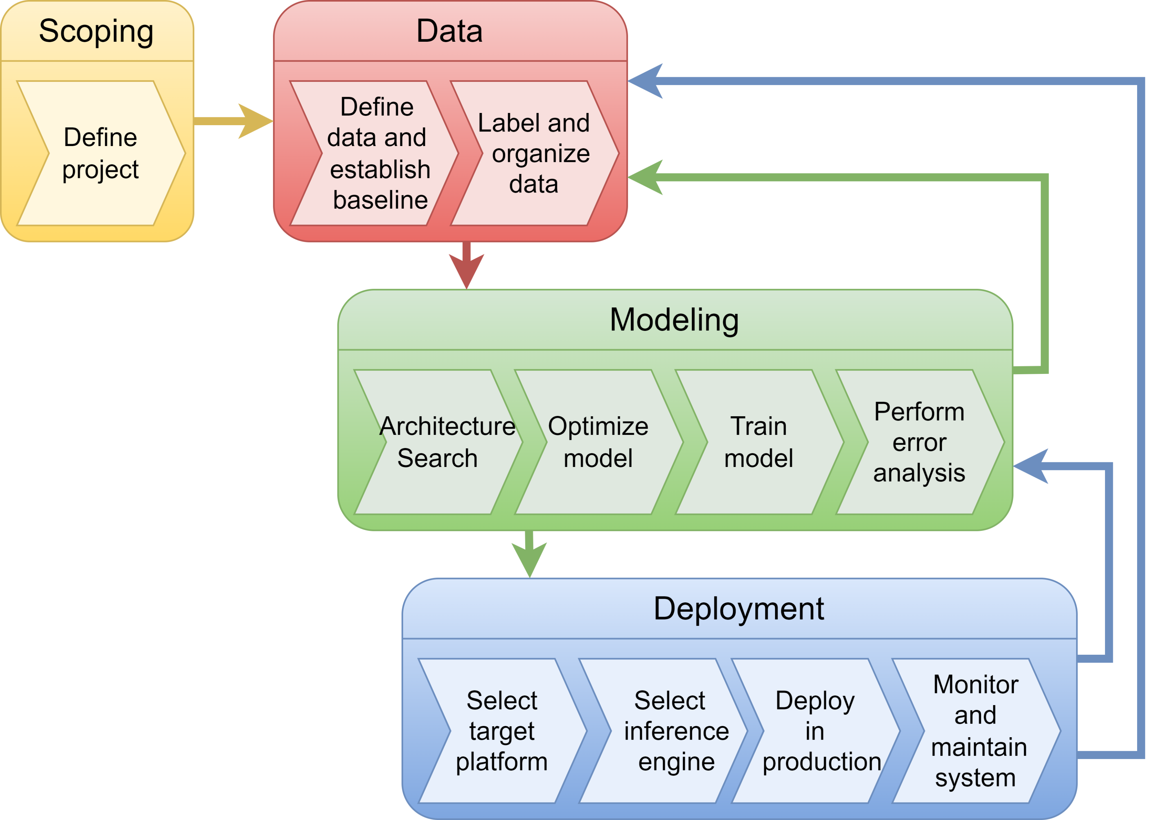
Proposed solution
A structured inference optimisation approach
Considering industrial brownfield architectures with existing legacy hardware and software
Four directions in the MLOps pipeline considered
DNN architecture selection
DNN model optimisation
Target deployment platform
Inference engine
Machine Learning Operations (MLOps) Pipeline

Slide 7
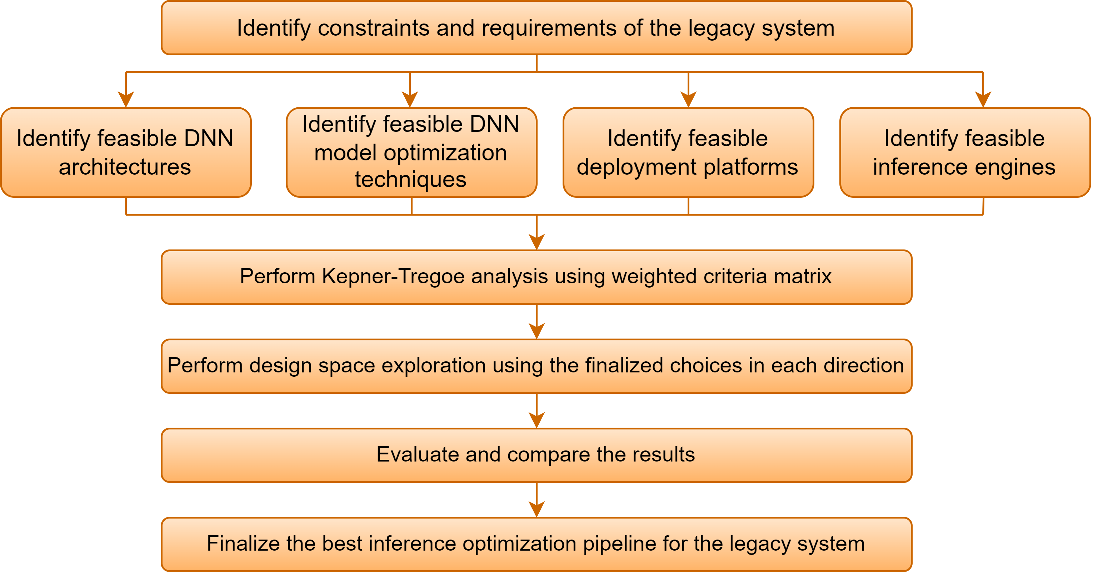
Structured Approach for DNN Optimization

Slide 8
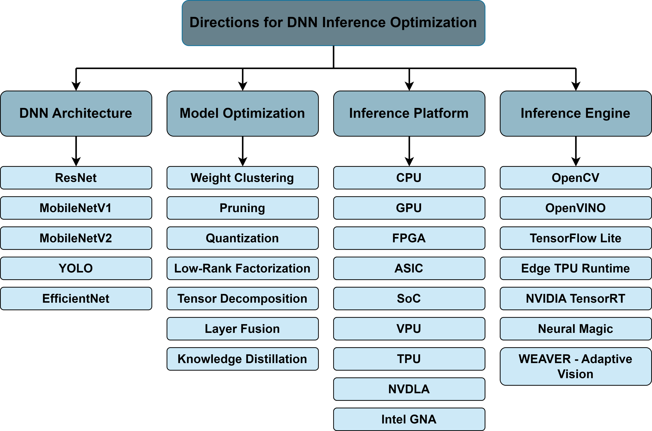
DNN Inference Optimization
Design aspects for DNN inference optimization

Slide 9
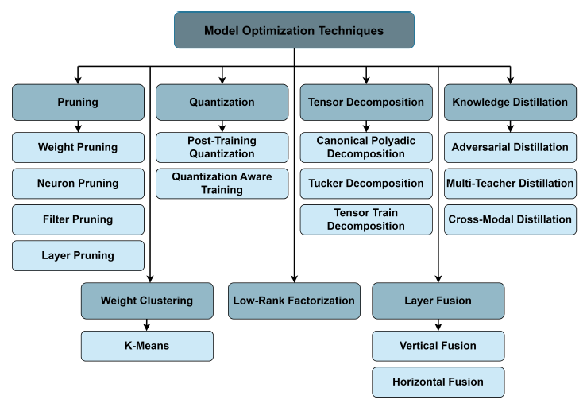
Model optimization techniques

Slide 10
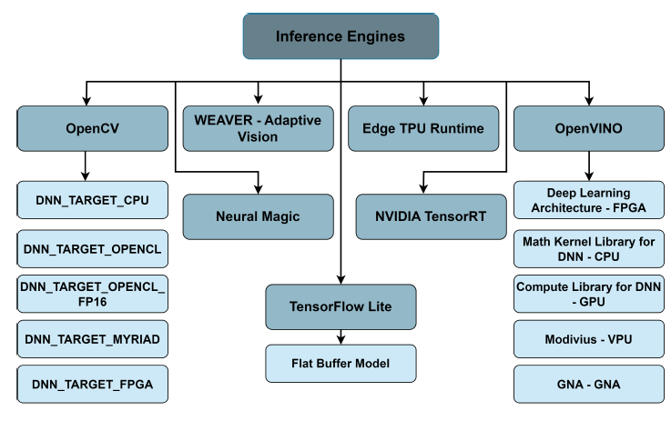
Inference engines

Slide 11
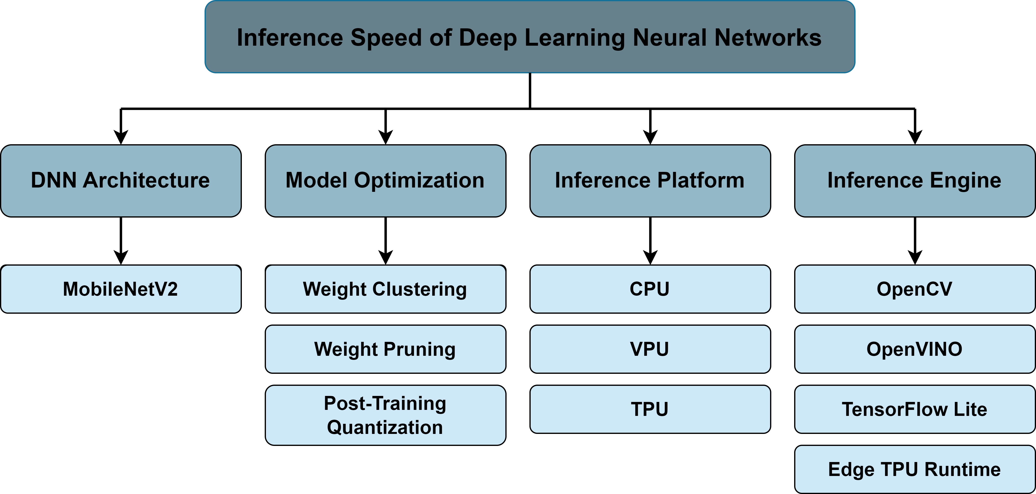
Chosen Optimization Techniques for the Use Case
Based on Kepner-Tregoe (KT) decision analysis using a weighted criteria matrix

Slide 12

Baseline Experimentation Results
Model | Inference Engine | MAE - X and Y | MAE - R | Inference Time (ms)
MobileNetV2 | OpenCV | 0.04485 | 0.0403 | 9.531
L is the actual label value of the image
P is the predicted value from the baseline TensorFlow model
o represents the output value - X, Y or R
n is the number of samples (≈3700 images)
i is the iteration counter
$${MAE(L, P)}_{o}= \frac{1}{n} \sum_{i=0}^{n −1}{\left|L_{i} − P_{i}\right|}$$

Slide 13
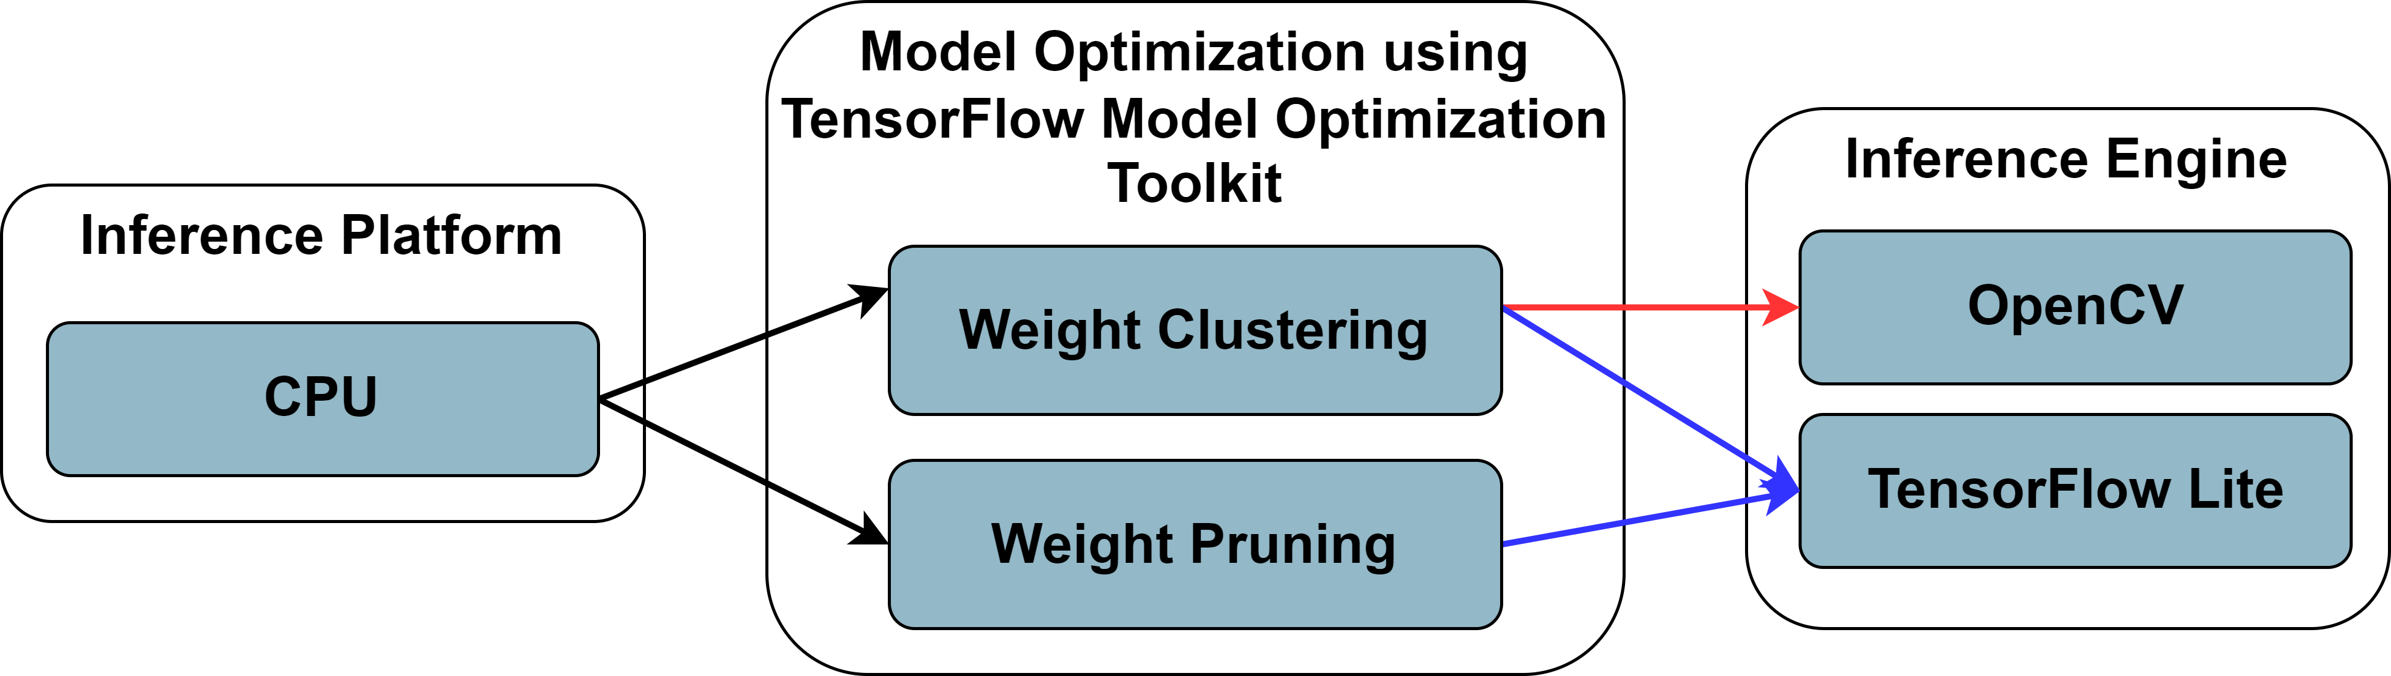
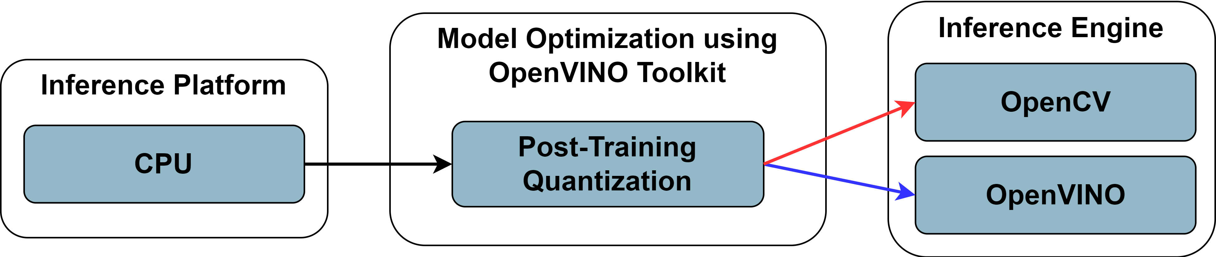
Design Space Exploration - CPU

Slide 14
Design Space Exploration - CPU
TensorFlow Lite base model on CPU
Model Optimization | Inference Engine | MAE - X and Y | MAE - R | Inference Time (ms)
TFLite Base | TensorFlow Lite | 0.04467 | 0.0393 | 5.265

Slide 15
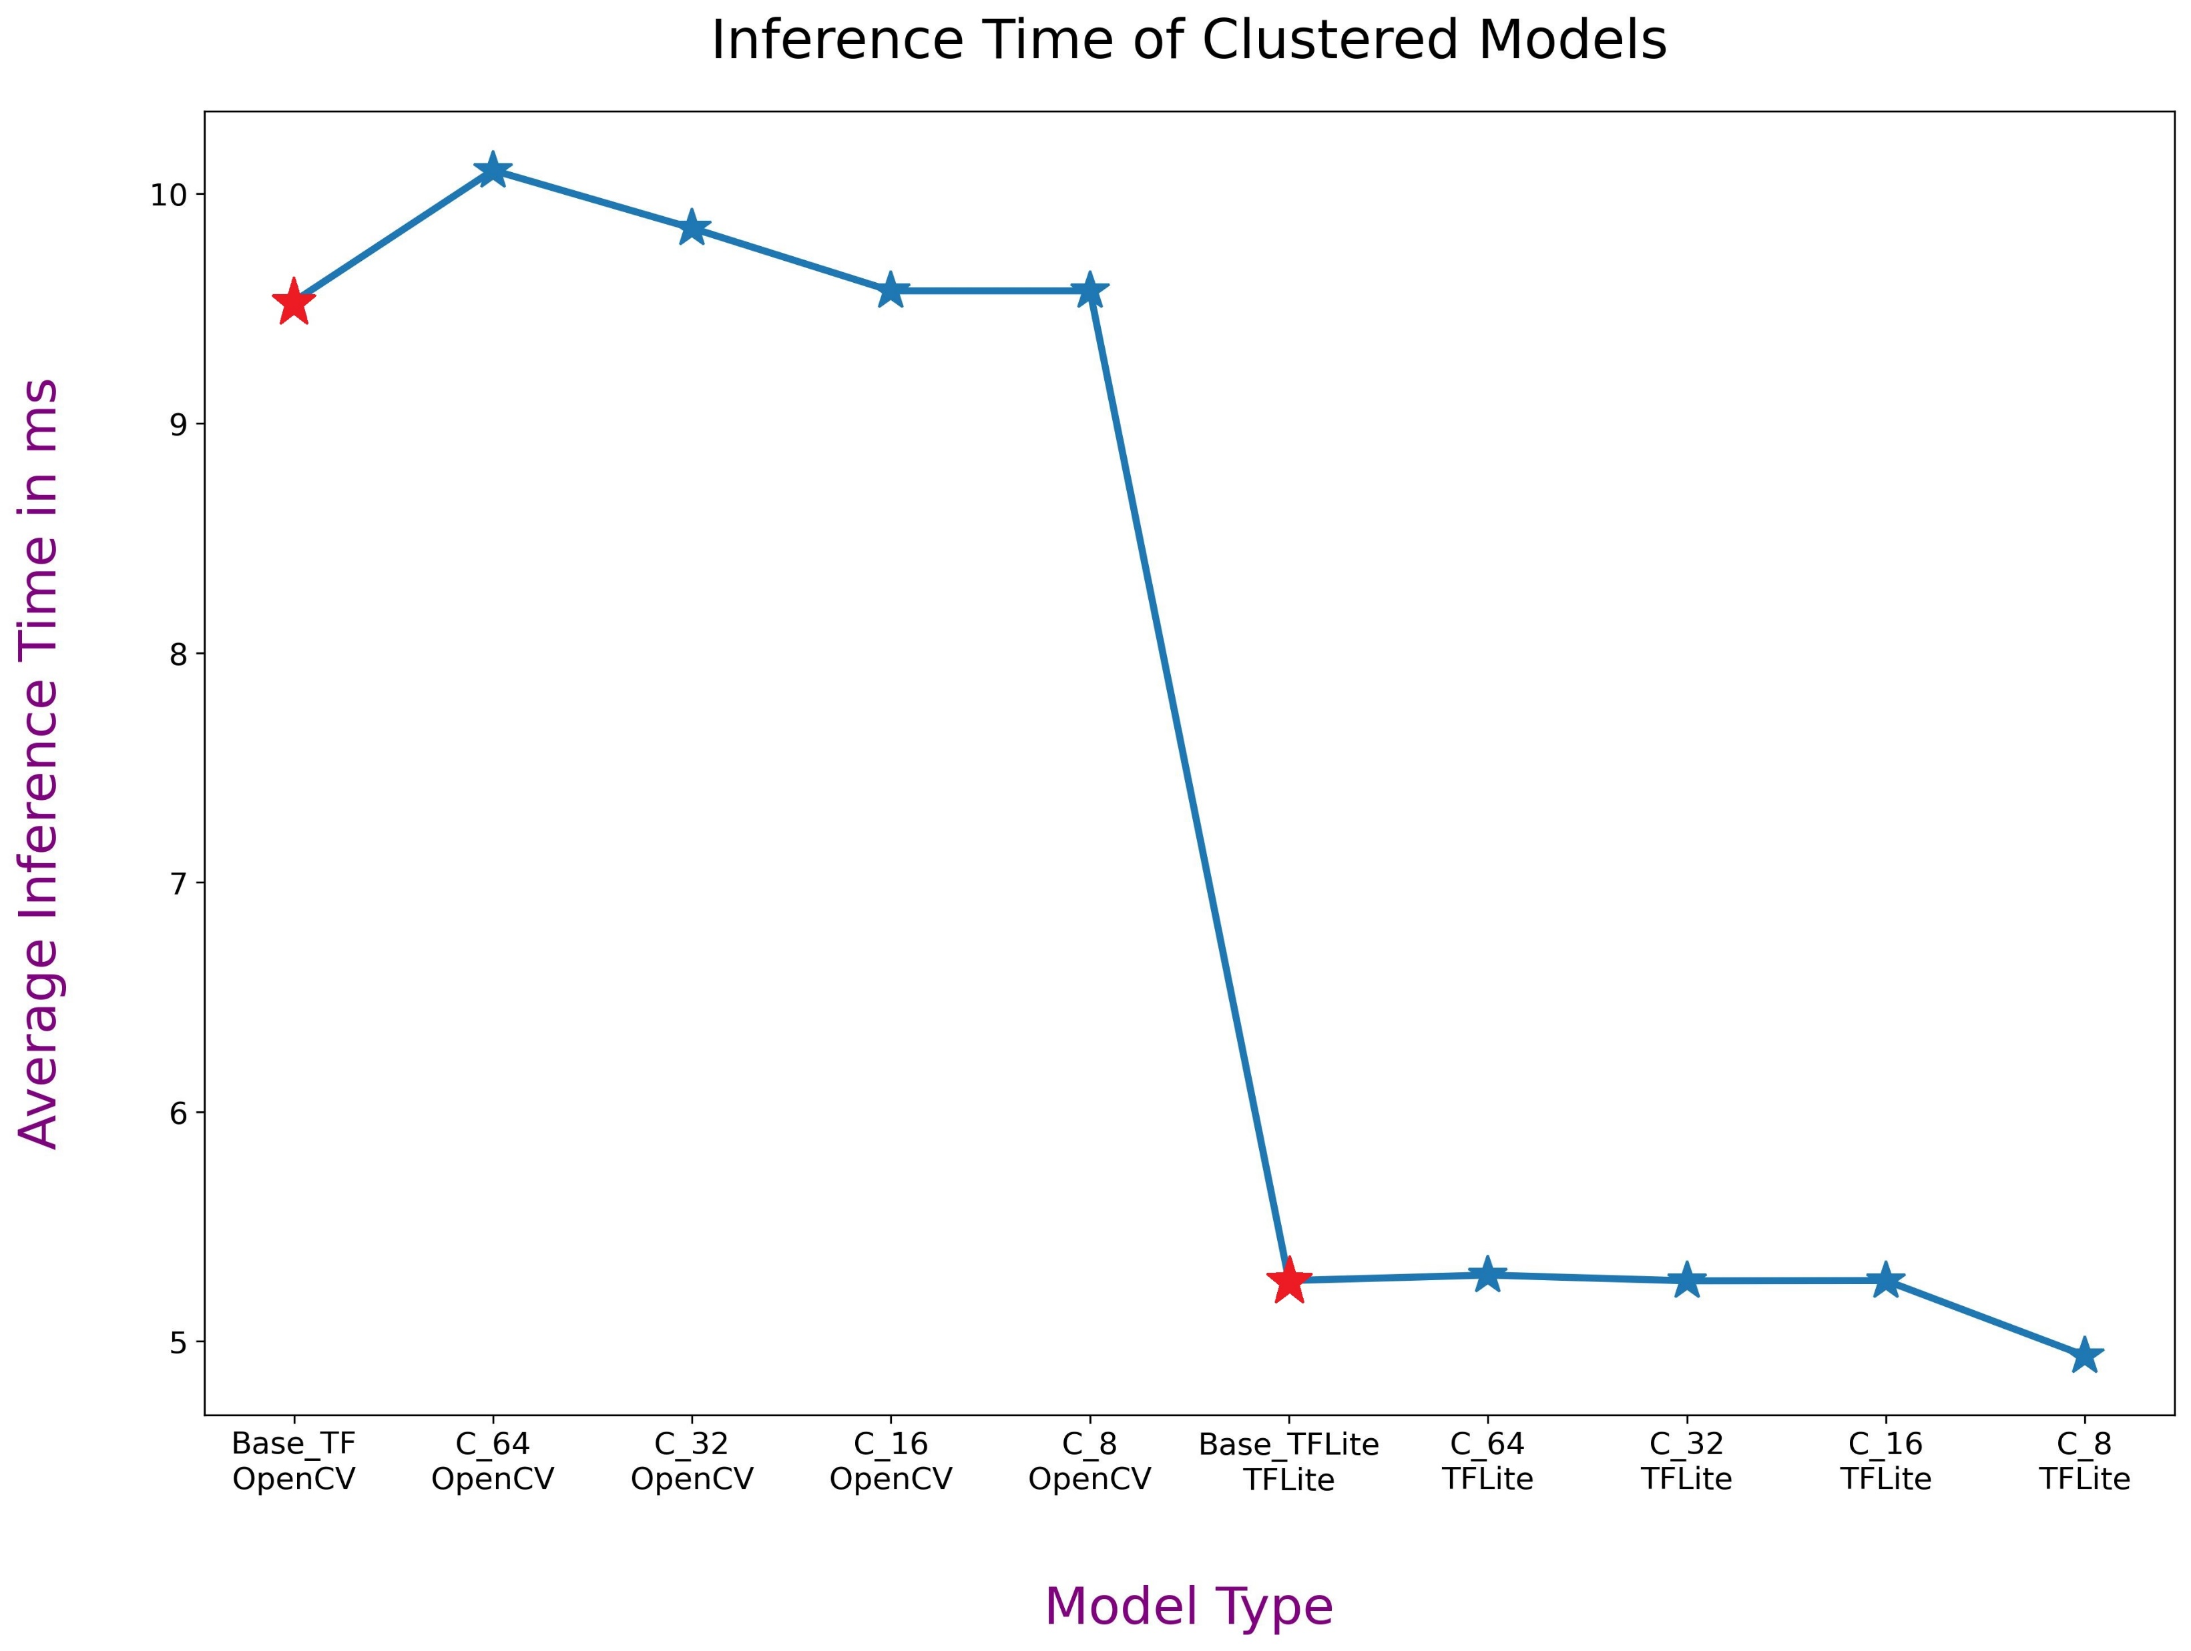
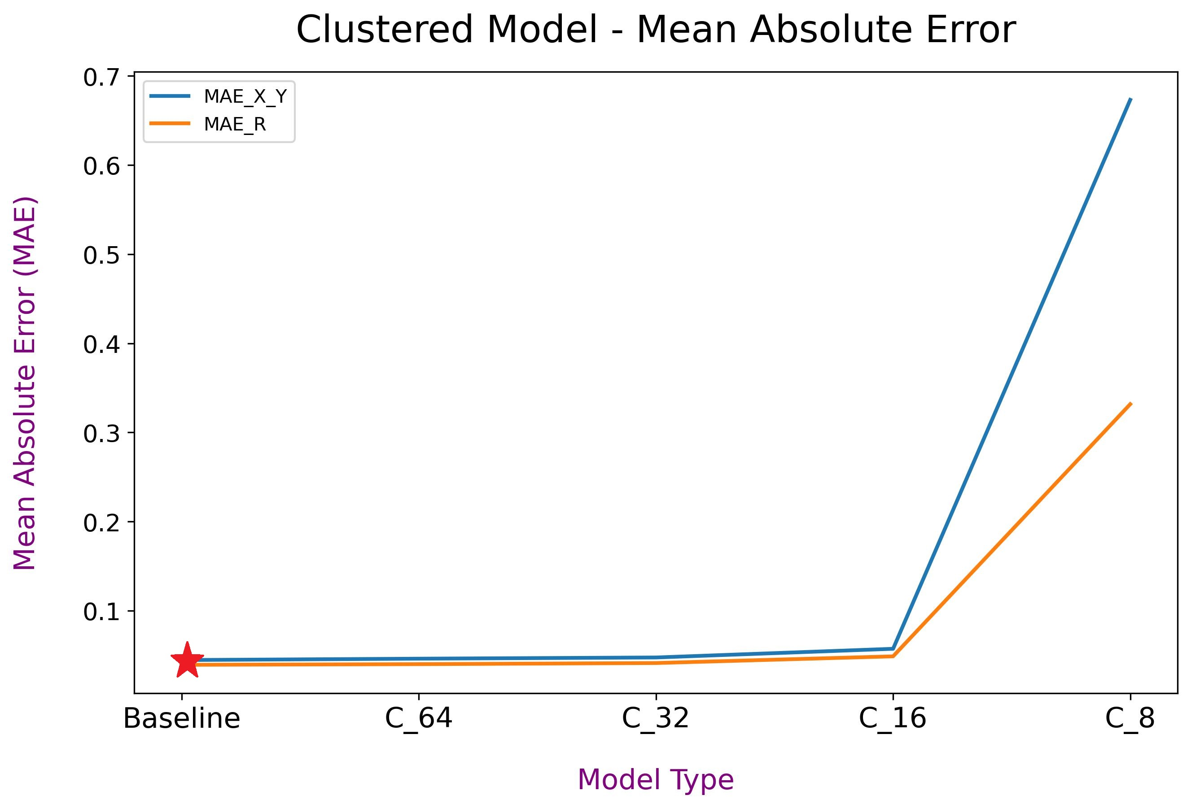
Design Space Exploration - CPU
Weight Clustering on CPU

Slide 16
Design Space Exploration - CPU
Weight Pruning on CPU
Model Optimization | Inference Engine | MAE - X and Y | MAE - R | Inference Time (ms)
0.50 Sparsity | TensorFlow Lite | 0.04407 | 0.03399 | 5.263
0.80 Sparsity | TensorFlow Lite | 0.05067 | 0.03685 | 5.265

Slide 17
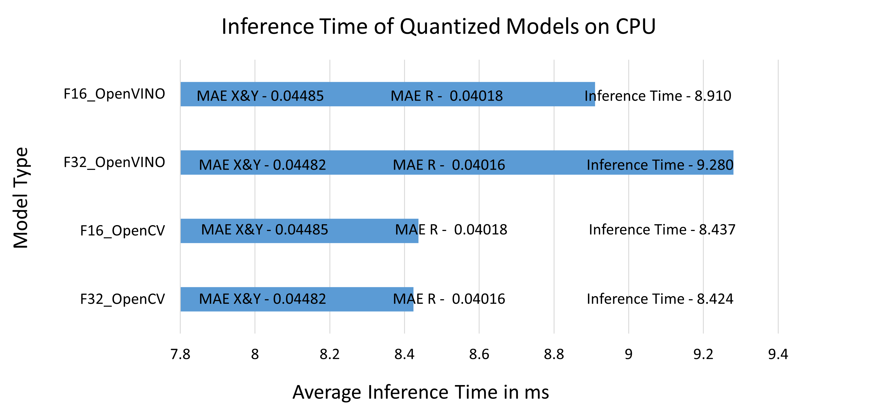
Design Space Exploration - CPU
Post-Training Quantization on CPU

Slide 18
Design Space Exploration– VPU, TPU
Quantization on VPU and TPU
Model Optimization | Inference Platform | Inference Engine | MAE - X and Y | MAE - R | Inference Time (ms)
OpenVINO float16 | VPU | Intel OpenVINO | 0.04485 | 0.04018 | 28.965
TFLite uint8 | TPU | TensorFlow Lite and Edge TPU Runtime | 0.06024 | 0.04567 | 7.115

Slide 19
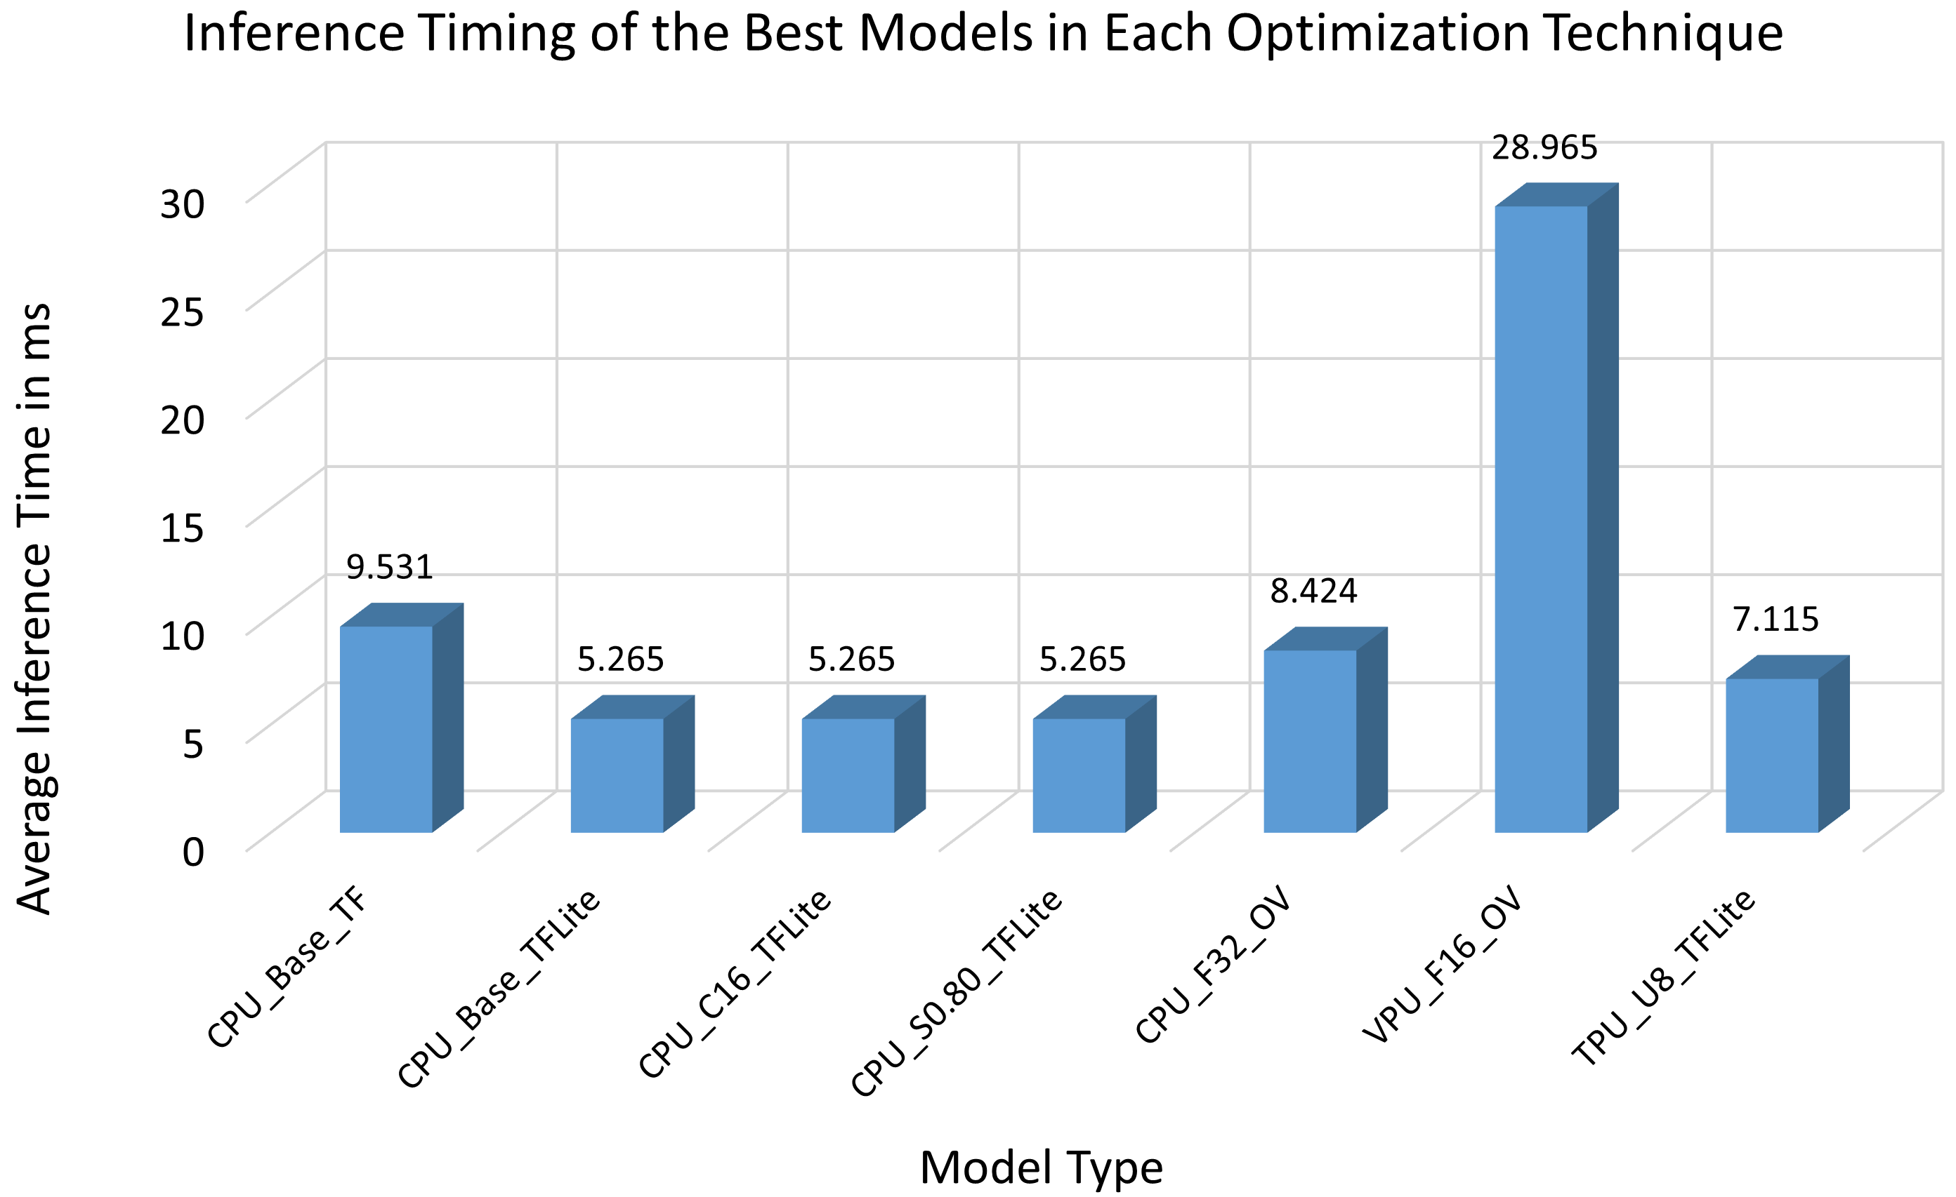
Discussion

Slide 20
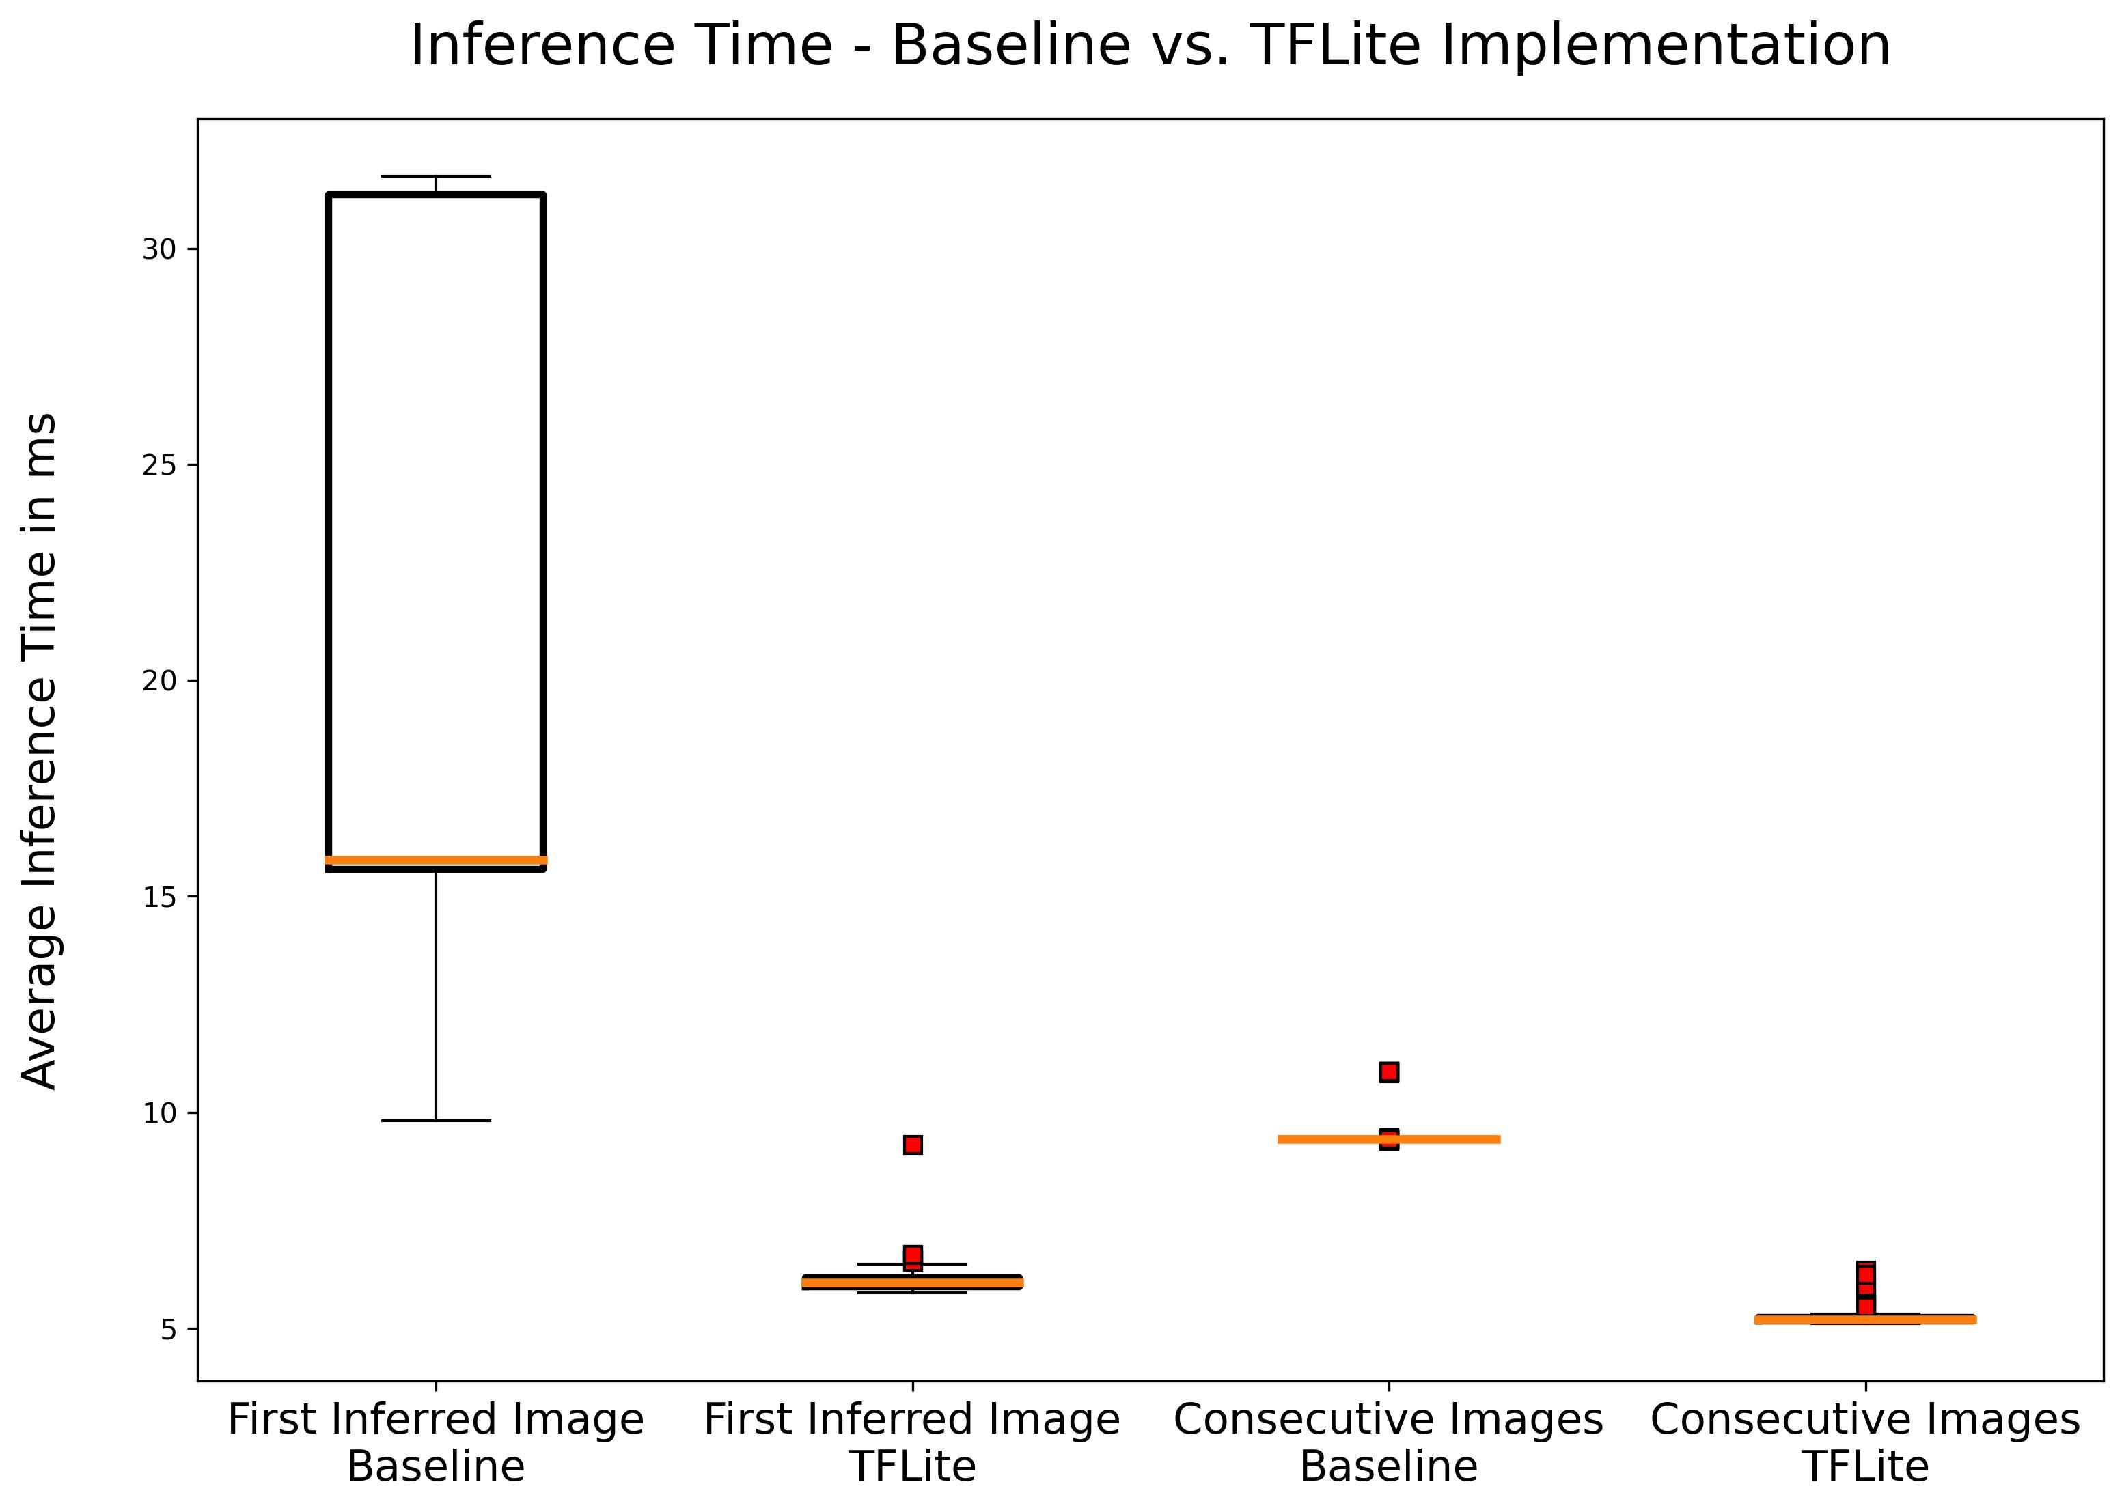
Conclusion
A structured inference optimisation approach for modelling and deployment of DNN in legacy systems
A Kepner-Tregoe (KT) decision analysis using a weighted criteria matrix performed for identification of applicable techniques
Four directions in the MLOps pipeline considered
DNN architecture selection
DNN model optimisation
Target deployment platform
Inference engine

Slide 21



Thanks! Questions?
sajid.mohamed@itecequipment.com
Connect with us:
Find more:
www.imoco4e.eu
@IMOCO4E
@IMOCO4E

